Slide 1


Teja Niduram
03/03/2024

Slide 2

Outline
Executive Summary
Introduction
Methodology
Results
Conclusion
Appendix

Slide 3
Executive Summary
Summary of all methodologies:
Used SpaceX API and Web Scraping for data collection, Plotly, Folium and Dash for data visualization, SQLite for exploratory data analysis.
We have Used Four types of methods in predicting that mission would be successful or not.
They are :
Logistic Regression
Support Vector Machine (SVM)
Decision Tree Classifier
K Nearest Neighbors
Used Grid Search CV to get best estimator and best model for the given problem
Summary of all results:
According to the Accuracy Scores of the Models the most efficient one is Decision Tree Classifier

Slide 4
Introduction
Project background and context:
The reason to choose SpaceX is its recovery of the first stage of a rocket
SpaceX has best pricing
It is more economic to use this SpaceX rockets
Problem:
SpaceY wants us to build a machine learning model to predict successful Stage1 recovery

Slide 5

Section 1

Slide 6
Methodology
Executive Summary
Data collection methodology:
Collected Data from SPACEX API
Perform data wrangling
Classified Successful and Unsuccessful missions and added a new column class to Data Frame
Perform exploratory data analysis (EDA) using visualization and SQL
Perform interactive visual analytics using Folium and Plotly Dash
Perform predictive analysis using classification models
Tuned Models using GridSearchCV

Slide 7
Data Collection
The Data sets are collected using SpaceX API calls and Web Scraping from SpaceX’s Wikipedia
The following slides gives us the brief information about the data collected using SpaceX API calls and SpaceX Wikipedia Web Scraping
SpaceX API calls Data Columns:
FlightNumber, Date, BoosterVersion, PayloadMass, Orbit, LaunchSite, Outcome, Flights, GridFins, Reused, Legs, LandingPad, Block, ReusedCount, Serial, Longitude, Latitude
Wikipedia Webscrap Data Columns:
Flight No., Launch site, Payload, PayloadMass, Orbit, Customer, Launch outcome, Version Booster, Booster landing, Date, Time

Slide 8
Data Collection – SpaceX API
DATACOLLECTION
(SPACEX API)
GitHub:
https://github.com/Teja5353/Capstone_DataScience/blob/main/jupyter-labs-spacex-data-collection-api.ipynb
Request(SpaceX API)
.Json File + List(Booster Version,LaunchSite,PayloadDate)
Json File to Data Frame using json_normalize
Filter data that only include Falcon 9
Cast Dictionary to Data Frame using pd.DataFrame
Add Relevant Data to Dictionary
Fill the missing data with mean of the column

Slide 9
Data Collection - Scraping
Using Request get html data of website
Using Beautiful Soup parse the data
Find Launch info table
Iterate over the table cell and extract data to a Dictionary
Convert the dictionary to Data Frame using pd.DataFrame
DATA COLLECTION
(WEB SCRAPING)
GitHub:
https://github.com/Teja5353/Capstone_DataScience/blob/main/jupyter-labs-webscraping.ipynb

Slide 10
Data Wrangling
Used Pandas Data Frame to process the data
First load the data into pandas data frame
Check for any missing values fill them with mean of the respective column data
Added a new column class according to success or failure of Mission Outcome
Value Mapping:
True ASDS, True RTLS, & True Ocean – set to -> 1
None None, False ASDS, None ASDS, False Ocean, False RTLS – set to -> 0
GitHub:
https://github.com/Teja5353/Capstone_DataScience/blob/main/labs-jupyter-spacex-Data%20wrangling.ipynb

Slide 11
EDA with Data Visualization
Exploratory Data Analysis performed on variables Flight Number, Payload Mass, Launch Site, Orbit, Class and Year.
Plots Used:
Flight Number vs. Payload Mass, Flight Number vs. Launch Site, Payload Mass vs. Launch Site, Orbit vs. Success Rate, Flight Number vs. Orbit, Payload vs Orbit, and Success Yearly Trend
Scatter plots, line charts, and bar plots were used to compare relationships between variables to decide if a relationship exists so that they could be used in training the machine learning model
GitHub:
https://github.com/Teja5353/Capstone_DataScience/blob/main/jupyter-labs-eda-dataviz.ipynb.jupyterlite.ipynb

Slide 12
EDA with SQL
SQL Queries used:
Selecting data which doesn't has date as NULL
Selecting unique Launch Site Names
Extracting total payload mass launched by NASA (CRS)
Extracted First Successful landing outcome Date on ground pad
Extracted names of booster which have success in drone ship
Extracted names of boosters which carried maximum payload
Used many more queries to get good understanding about data
GitHub Url:
https://github.com/Teja5353/Capstone_DataScience/blob/main/jupyter-labs-eda-sql-coursera_sqllite.ipynb

Slide 13
Build an Interactive Map with Folium
Added Circles, Markers to the folium Map
Circles were added to easily identify the range of the launch site
Markers were added to the folium map to identify the exact location of the Launch Site
By adding them we can easily get the location and range of the Launch Sites in the map
GitHub URL:
https://github.com/Teja5353/Capstone_DataScience/blob/main/lab_jupyter_launch_site_location.jupyterlite.ipynb

Slide 14

Build a Dashboard with Plotly Dash
Pie chart representing Success rate of ALL Launch Sites, Pie chart representing Success rate of each Launch site selected from the Dropdown
A Range Slider is used to get Maximum and Minimum range of Payload Mass in KG
A Scatter Plot is used to represent the relation between selected range of payload mass and select launch by differentiating scatter points with Class of the data
We have added these plots to get a good understanding about Success rate of each launch site within the range of payload mass
GitHub URL:
https://github.com/Teja5353/Capstone_DataScience/blob/main/spacex_dash_app.py

Slide 15
Predictive Analysis (Classification)
Used Grid Search CV to get best estimator from the available parameters of a model
Used four Algorithms : KNN,SUPPORT VECTOR MACHINE,DECISION TREE,LOGISTIC REGRESSION
By finding its accuracy score found the best model for predicting the result
Drop ‘Class’ column from the data frame and assign it to variable Y
Use Standard Scalar to normalize the data
Use train_test_split to split data into training and testing set
Choose an Algorithm like KNN
Plot a Bar Graph model vs Accuracy(score) to choose a best model for prediction
Plot confusion matrix for all the models
Calculate the score of the model
Use GridSearchCV to get optimal hyperparameters
GitHubURL:https://github.com/Teja5353/Capstone_DataScience/blob/main/SpaceX_Machine_Learning_Prediction_Part_5.jupyterlite.ipynb

Slide 16
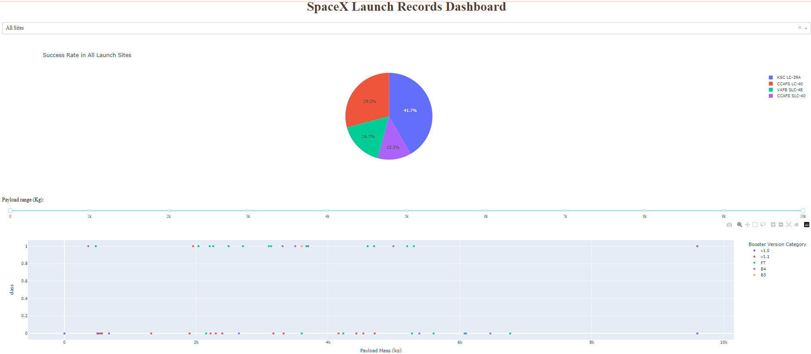
Results
Above screenshot is of a dashboard created for interactive visualization of launch site success rate from user input as launch site and payload mass range, Exploratory Data Analysis is done by SQL
The predictive model is of accuracy 83% and to improve it we need more data to train and test the model.

Slide 17

Section 2

Slide 18
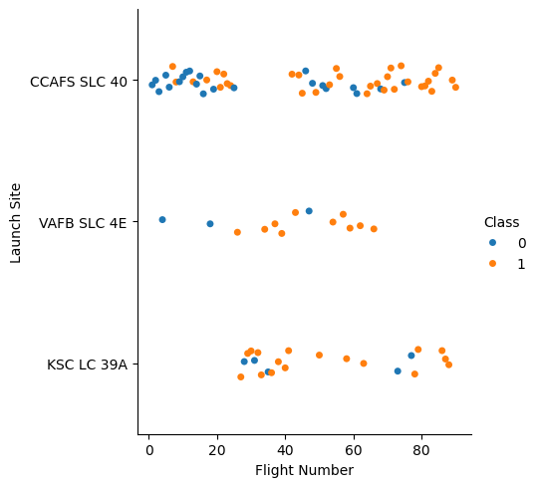
Flight Number vs. Launch Site
From the Above plot we can observer that From Flight Number more than 80 CCAFS SLC 40 launch site has high success

Slide 19
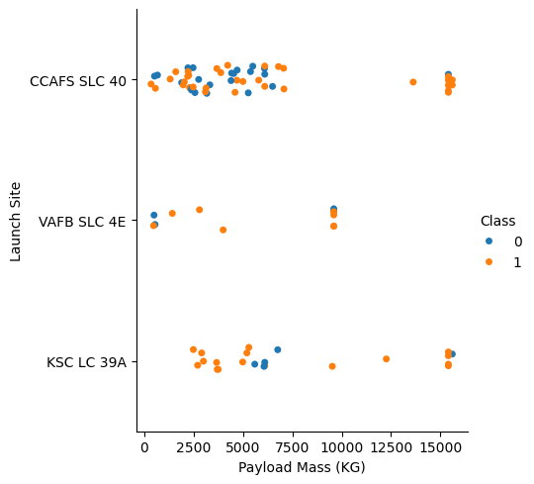
Payload vs. Launch Site
From the plot we can observe that at high Payload Mass CCAFS SLC 40 has high Success Rate
At low Payload Mass KSC LC 39A has More Success Rate
CCAFS SLC 40 can handle High Payload Mass

Slide 20
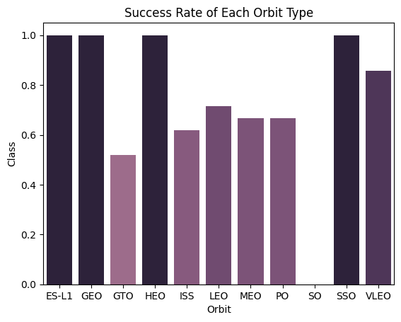
Success Rate vs. Orbit Type
From the plot we can observe that
Orbits with 100% success rate:
ES-L1
GEO
HEO
SSO
Orbits with 0% success rate:
SO
Class describes the Success rate of the SpaceX Rocket Mission to the Orbit

Slide 21
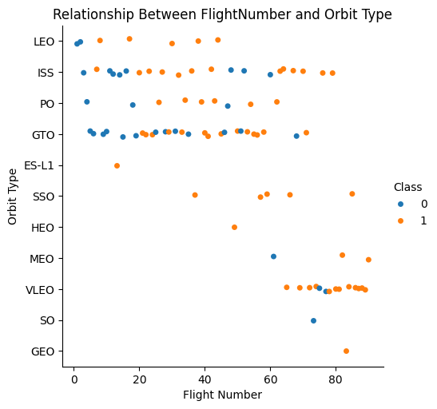
Flight Number vs. Orbit Type
From the plot we can observe that Above flight number 80 VLEO has more success rate
From Flight Number 20 to 40 ISS,LEO and PO orbits has good success rate
From 60 to 80 Flight Number ISS orbit has high success rate

Slide 22
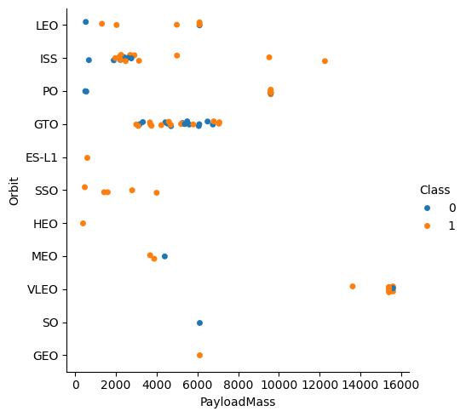
Payload vs. Orbit Type
The given plot shows the relation between Payload Mass and Orbit Type
We can observe that VLEO Orbit is suitable for high payload mass
SSO orbit is more suitable for low payload mass (2000 kg – 4000 kg)

Slide 23
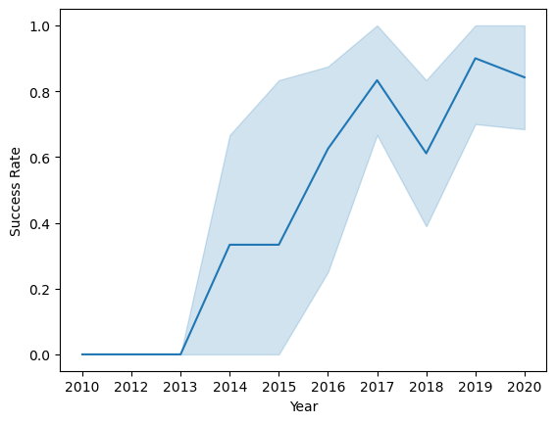
Launch Success Yearly Trend
Line chart shows an increasing in success rate year by year
There is a dip in success rate in 2018 and 2020
Launch Success is gradually increasing

Slide 24
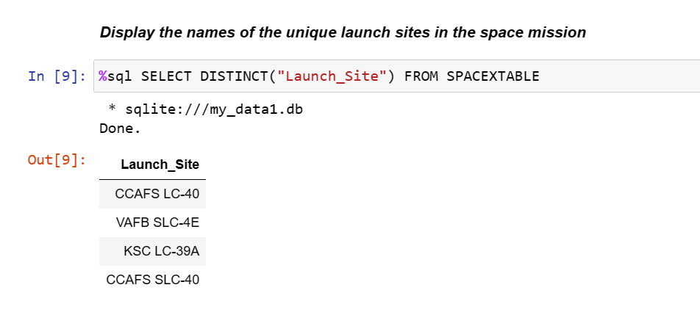
All Launch Site Names
Its is a Select Query to extract all unique Launch Site names from the table SPACEXTABLE

Slide 25
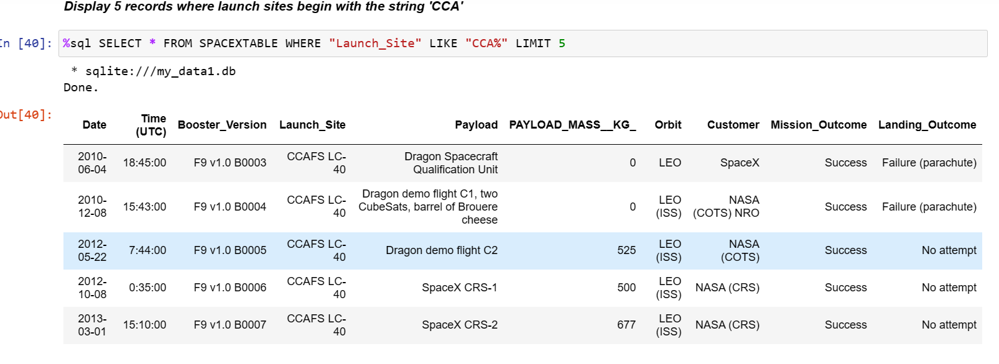
Launch Site Names Begin with 'CCA'
The above Query give all the data of the Launch Sites whose name begins with CCA

Slide 26
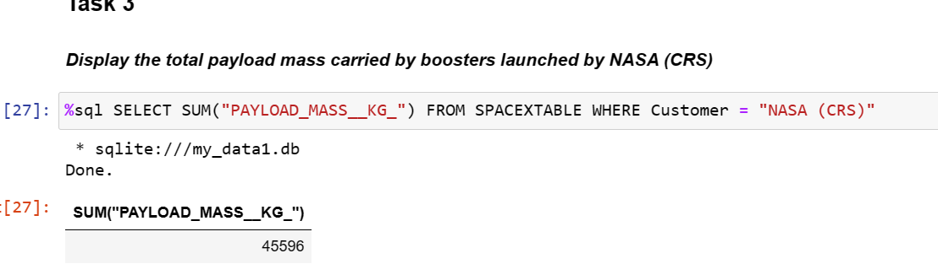
Total Payload Mass
The above SQL query is used to obtain total payload mass carried by NASA (CRS)
It use Aggregator SUM()

Slide 27
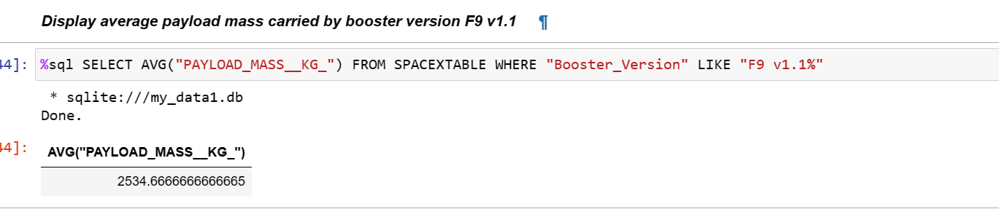
Average Payload Mass by F9 v1.1
The above SQL query give average payload mass carried by Booster Version of “F9 V1.1”
It uses Aggregator AVG()

Slide 28
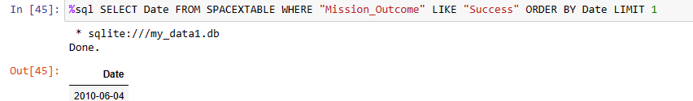
First Successful Ground Landing Date
Above SQL query extract the first successful ground landing date
It is more important to know the successful landing date so that we can start visualize data from that year or date

Slide 29
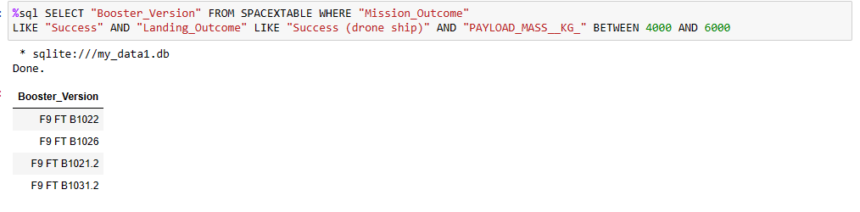
Successful Drone Ship Landing with Payload between 4000 and 6000
The above SQL query is used to extract Booster Version which has payload mass between 4000kg and 6000kg and Success in drone ship

Slide 30
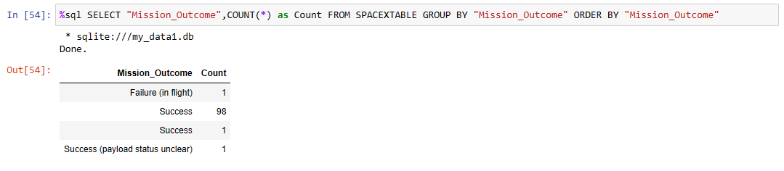
Total Number of Successful and Failure Mission Outcomes
The above SQL query extracts total number of successful and failure mission outcomes

Slide 31
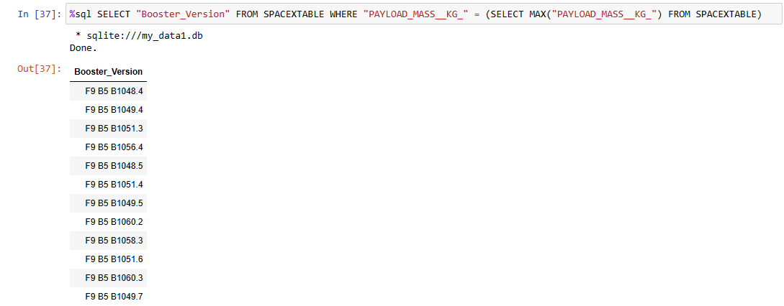
Boosters Carried Maximum Payload
The above SQL query extracts Booster Version names which have carried maximum payload mass
It uses Subquery to extract Maximum payload mass

Slide 32
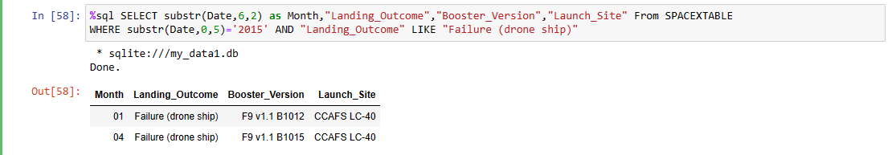
2015 Launch Records
The above SQL query extracts month, Booster Version, Launch Site name which failed in landing in 2015
It is important to know which launch site and booster version has failure in a respective year

Slide 33
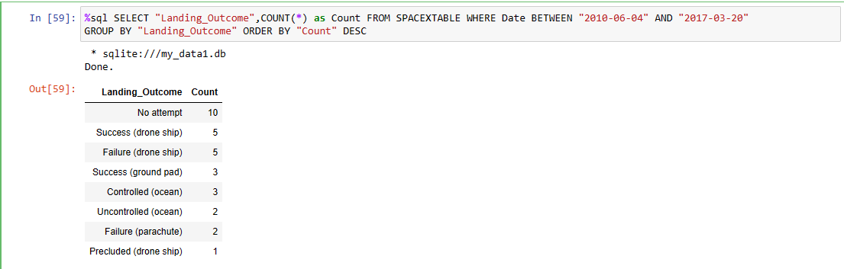
Rank Landing Outcomes Between 2010-06-04 and 2017-03-20
The above SQL query extracts the count of Landing outcomes in descending order from 2010-06-04 to 2017-03-20

Slide 34

Section 3

Slide 35
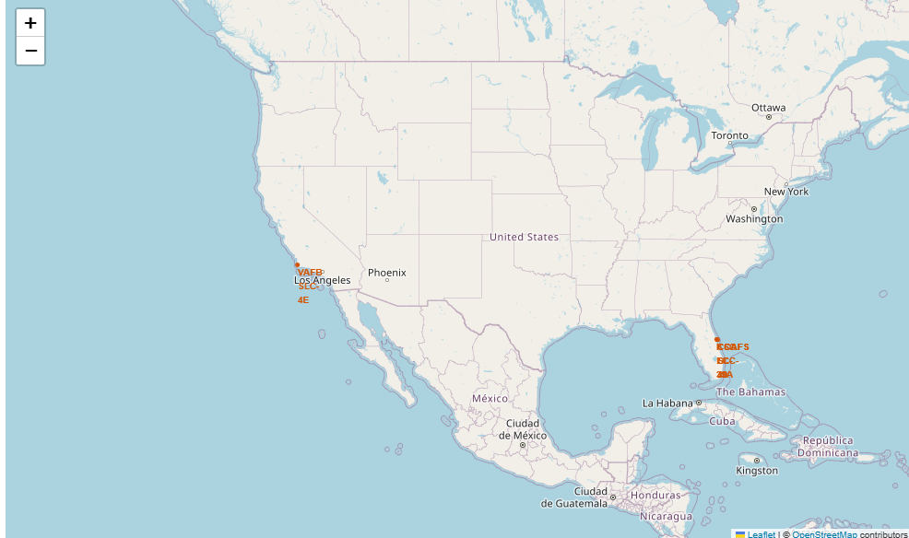
Marking Launch Sites on Map using Folium
Using Folium.Marker and Folium.Circle we have Marked the all launch site locations on the map

Slide 36
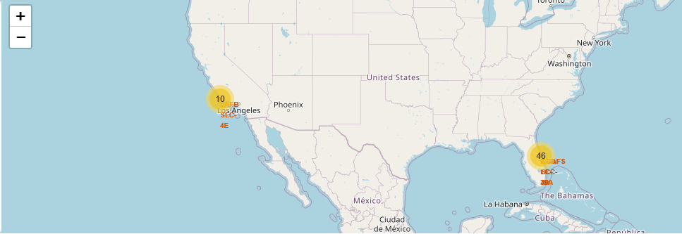
Marking the Launch Sites according to Landing Outcomes
Using The Landing outcome Information created a new column in a data frame called marker colour which is green when Landing outcome is Success else red
Using Folium.Marker added a marker Icon to the launch site locations with the respective marker colours and it show total number of launches in the map

Slide 37
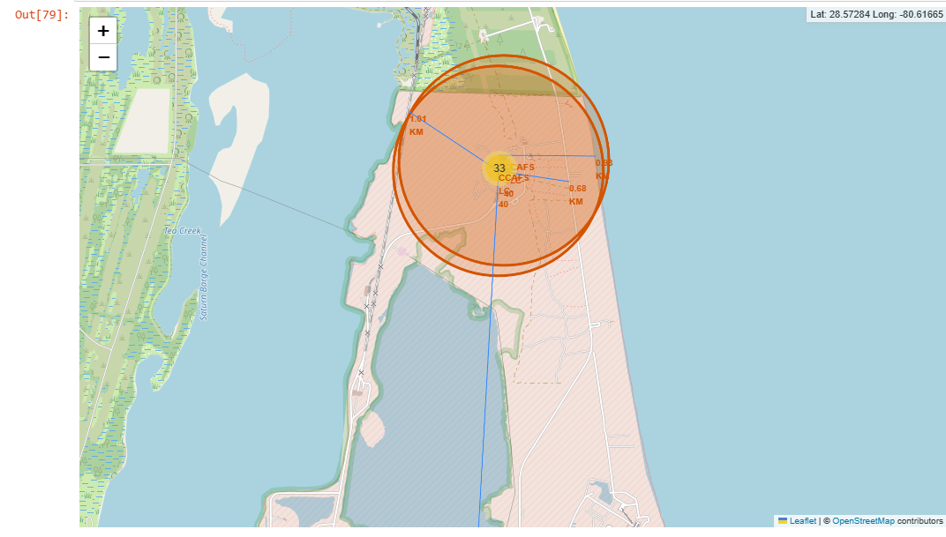
Nearest Locations to Launch Site
From the above observation we can say that launch sites are far from cities and near to the seas or oceans to make sure that there is no human loss while crash landing

Slide 38

Section 4

Slide 39
Success Rate of All Launch Sites in a Dashboard
From the above pie chart we can clearly see that Launch site KSC LC-39A has the highest success rate followed by CCAFS LC-40
Above pie chart gives the success rate of all launch sites

Slide 40
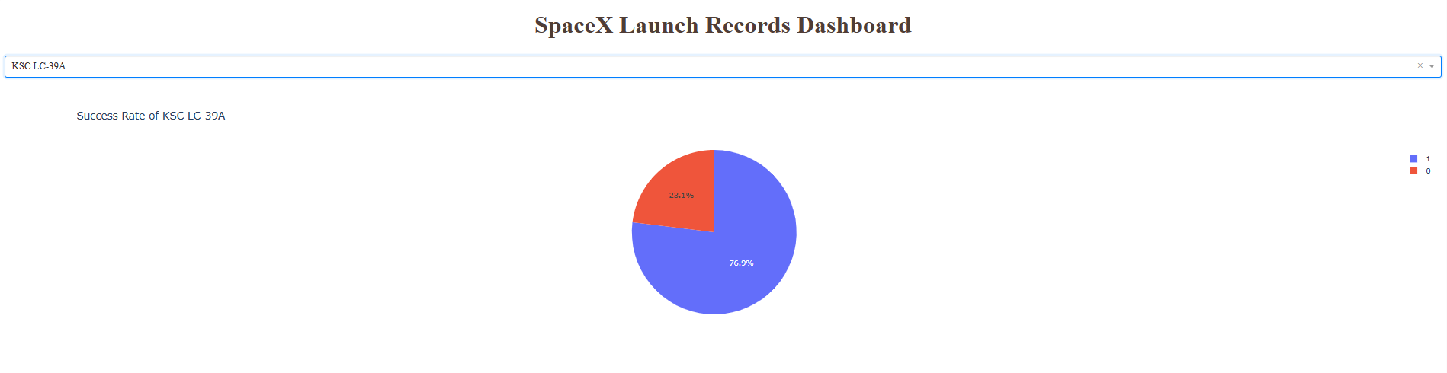
Launch Site with Highest success rate
From the above pie chart we can say that KSC LC-39A has success rate of 76.9% which is highest of all the other launch sites

Slide 41
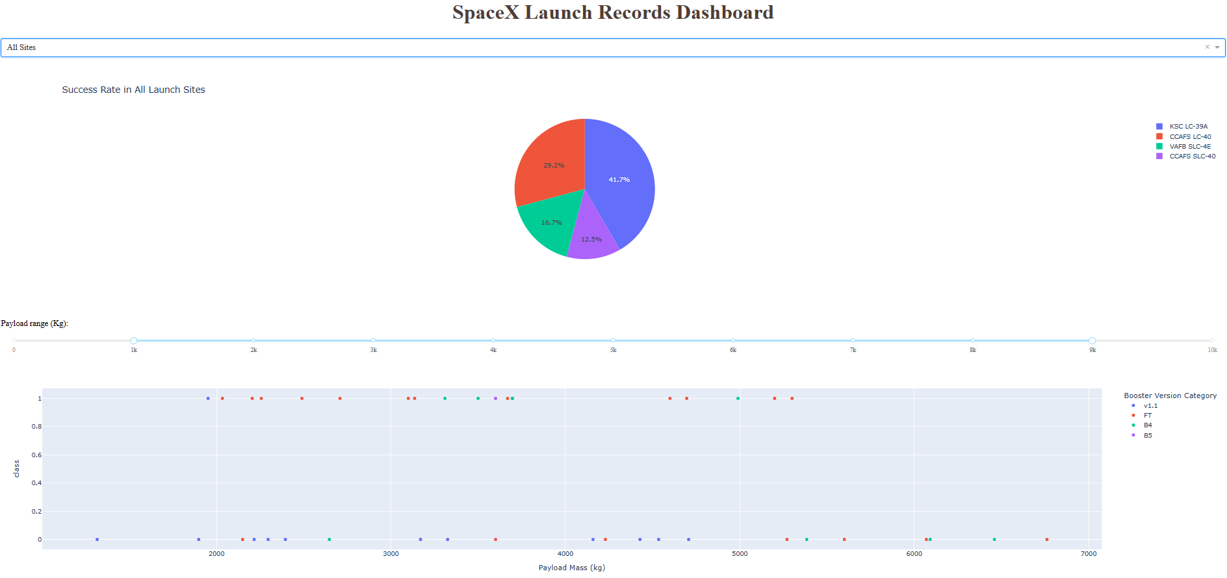
Dashboard with Payload mass as input
In the payload mass range of 1000kg – 9000kg Booster Version FT has more success according to the scatter plot

Slide 42

Section 5

Slide 43
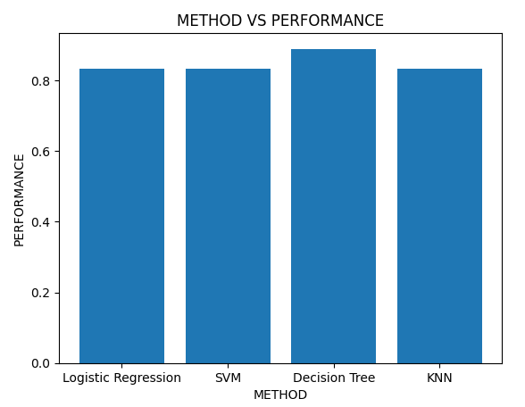
Classification Accuracy
The bar graph shows the accuracy of the various models used for prediction.
The highest accuracy is for the Decision tree model which is 93.33%
To improve the accuracy of the models we need more data to train and test them

Slide 44
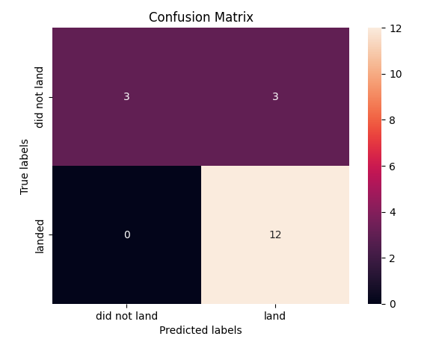
Confusion Matrix
The confusion matrix shows that the model is predicting the landing with 100% accuracy
Its is predicting unsuccessful landing with 50% accuracy

Slide 45
Conclusions
We have predicted the successful and unsuccessful landing of the rocket with given data
Decision Tree model is providing more accurate results than other model with the given data
We need more data to predict the success and unsuccessful landing more accurately

Slide 46
Appendix
Used Plotly dash to make Dashboard which works with user inputs
Used Matplotlib and seaborn for data visualization
Used plots like scatter plot, pie chart, line plot, bar plot for visualizing the data
Used SQLite for exploratory Data Analysis
Added a Class column which is 1 when successful landing and else 0
Used Decision Tree, Support Vector Machine, K Nearest Neighbors, Logistic Regression for predicting the class variable
Used GridSearchCV with cv as 10 for selecting best hyperparameter

Slide 47


